Slide 1
An Effective Region-Based Image Retrieval Framework
Feng Jing, Mingjing Li, Hong-Jiang Zhang, Bo Zhang
Speaker: Shihn-Yuarn Chen
2003.07.23

Slide 2
Outline
Introduction
Image Representation
Region-Based Retrieval
Relevance Feedback
Continuous Learning

Slide 3
Introduction
The performance of CBIR systems is limited by the gap between low-level features and high-level semantic concepts.
  Use region-based features and relevance feedback to reduce the gap
Region-based IR system
  The definition of the image similarity measure.
  How to make it scalable?
  The strategy of relevance feedback

Slide 4
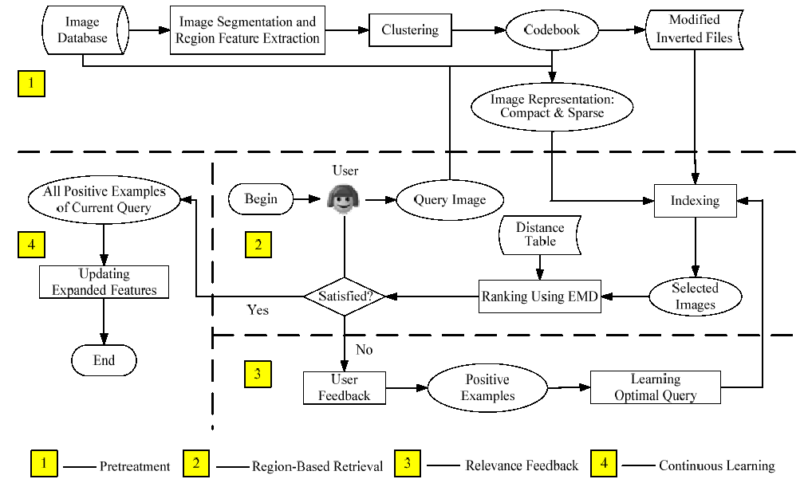
Introduction (cont.)

Slide 5
Image Representation
Image Segmentation
  Segment images into homogeneous regions.
  JSED algorithm
Region Properties
  User low level features of a region and their importance weight to represent the region properties.
Region Clustering
  Similar to vector quantization (VQ)
  Generalized Lloyd Algorithm (GLA)
  Stores the information of the cluster that a region belongs to.

Slide 6


Image Representation (cont.)
Compact and Sparse Representations
  An image can be described as a set of regions. (compact, used in storage and retrieval process)
    contains n regions {R₁, …, R_{n}}
    = {(CI_{R1}, W_{R1}), …, (CI_{Rn}, W_{Rn})}
    CI_{Ri}: codeword index (region property)
    W_{Ri}: importance weight
  An image is a vector with each dimension corresponding to a codeword. (sparse, used in relevance feedback)
    = { w₁, w₂, …, w_{n}}

Slide 7
Region-Based Retrieval
Image Similarity Measure
  Earth Mover’s Distance (EMD)
  Integrated Region Matching (IRM)
Indexing Using Modified Inverted File
  Expand at most k codewords to regions with larger weights.

Slide 8
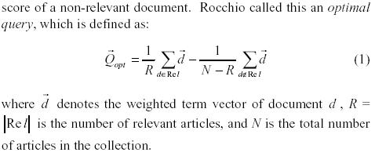
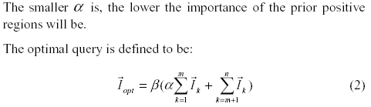
Relevance Feedback
Rocchio’s algorithm
Weighted Query Expansion
Region Pruning
  Prune smaller weight codewords

Slide 9
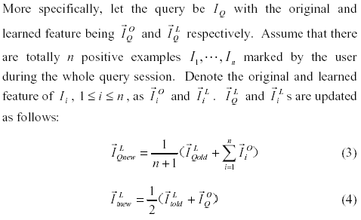

Continuous Learning
Updating Learned Feature
Using Learned Feature

Slide 10
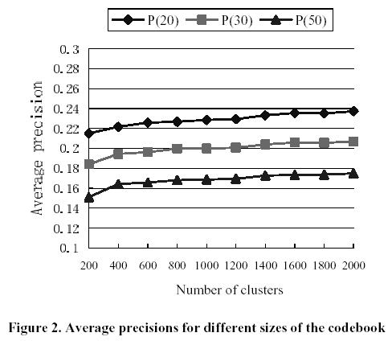
Experiments

Slide 11
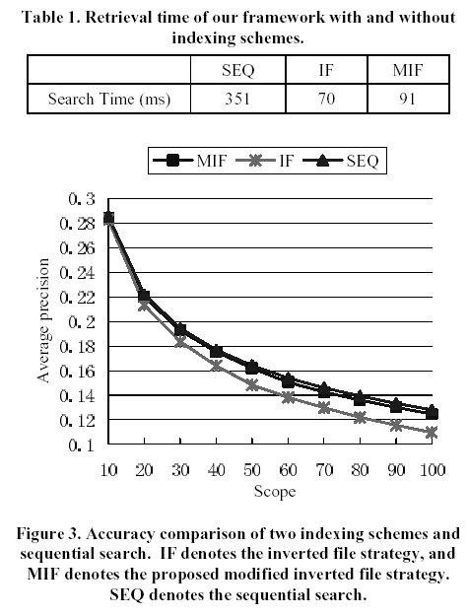
Experiments (cont.)

Slide 12
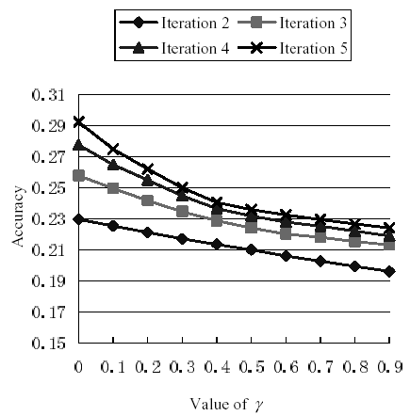
Experiments (cont.)

